Slide 1
Whittaker Moss Primary School Council
Highlights 2024 - 2025

Slide 2
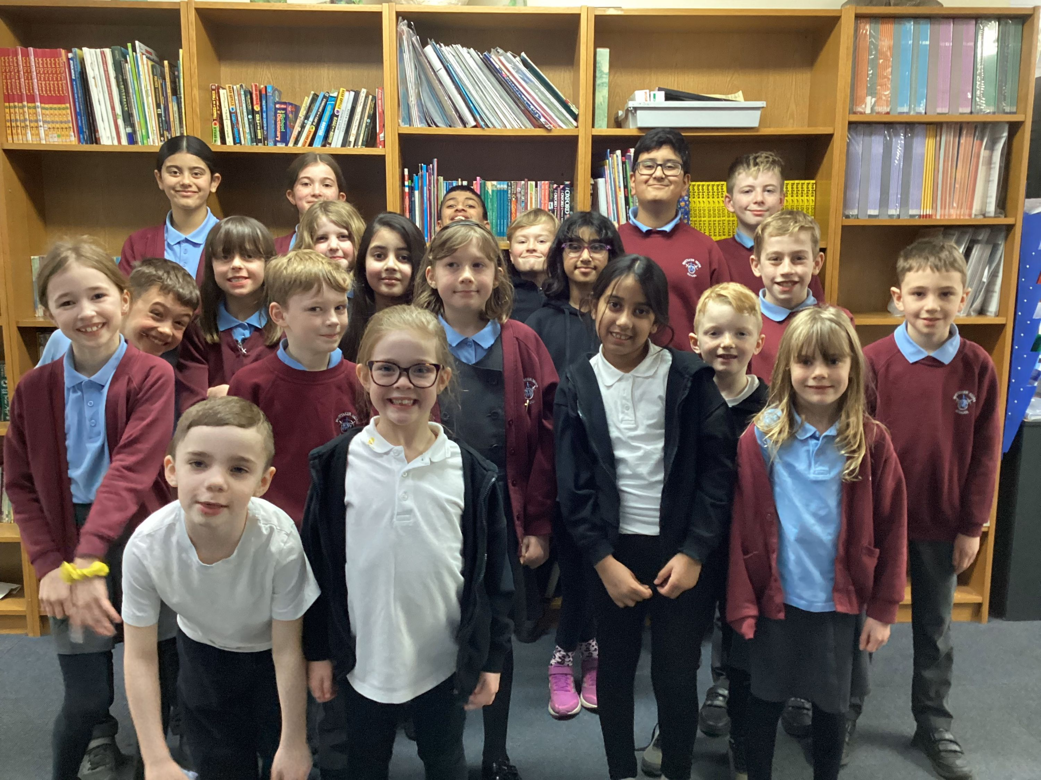
SCHOOL COUNCIL 2024 -2025

Slide 3
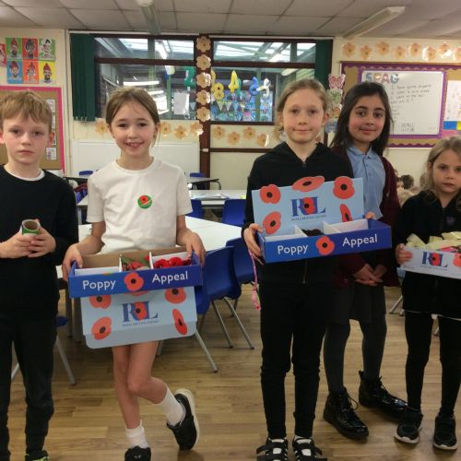
Poppy Appeal
We raised money by selling poppies for the Royal British Legion.

Slide 4
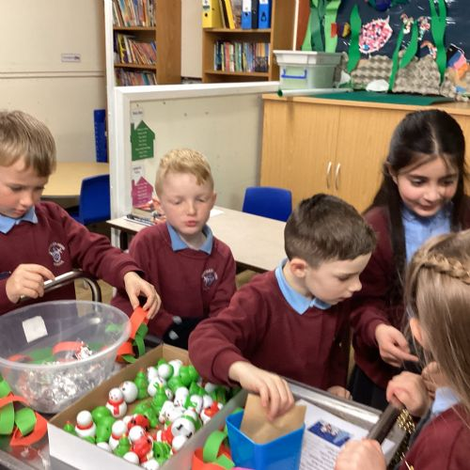
Christmas Trolley
We raised over £800 for school by selling Christmas stationery from our trolley.

Slide 5
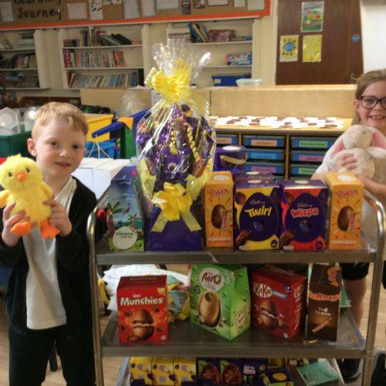
Easter Raffle
We raised over £500 for school with our Easter raffle.

Slide 6
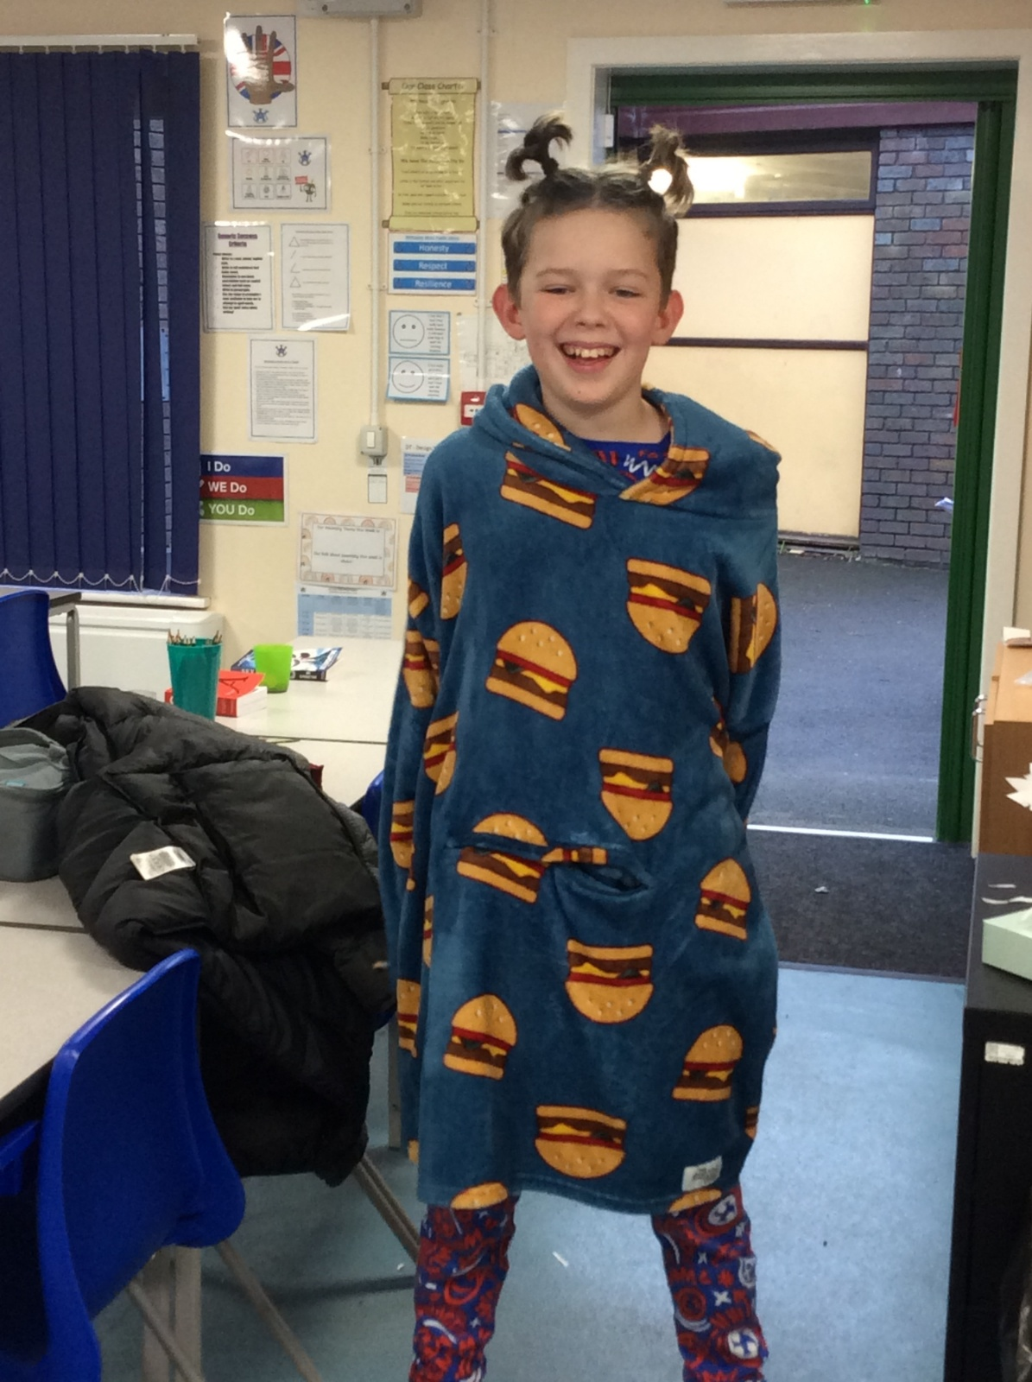
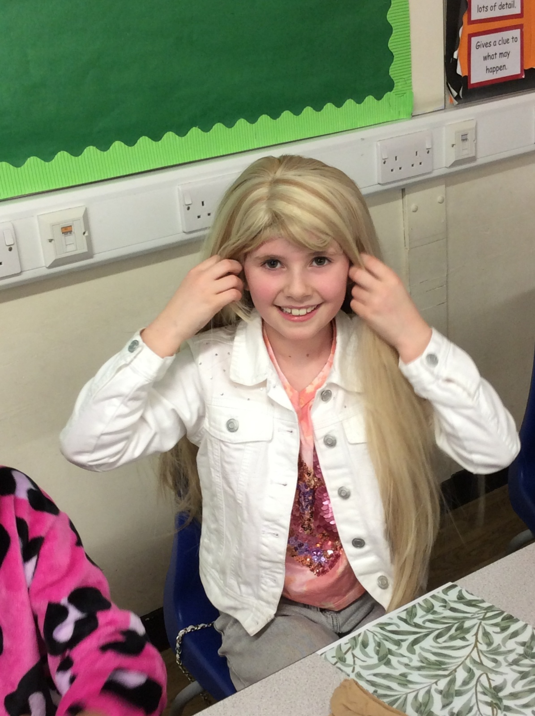
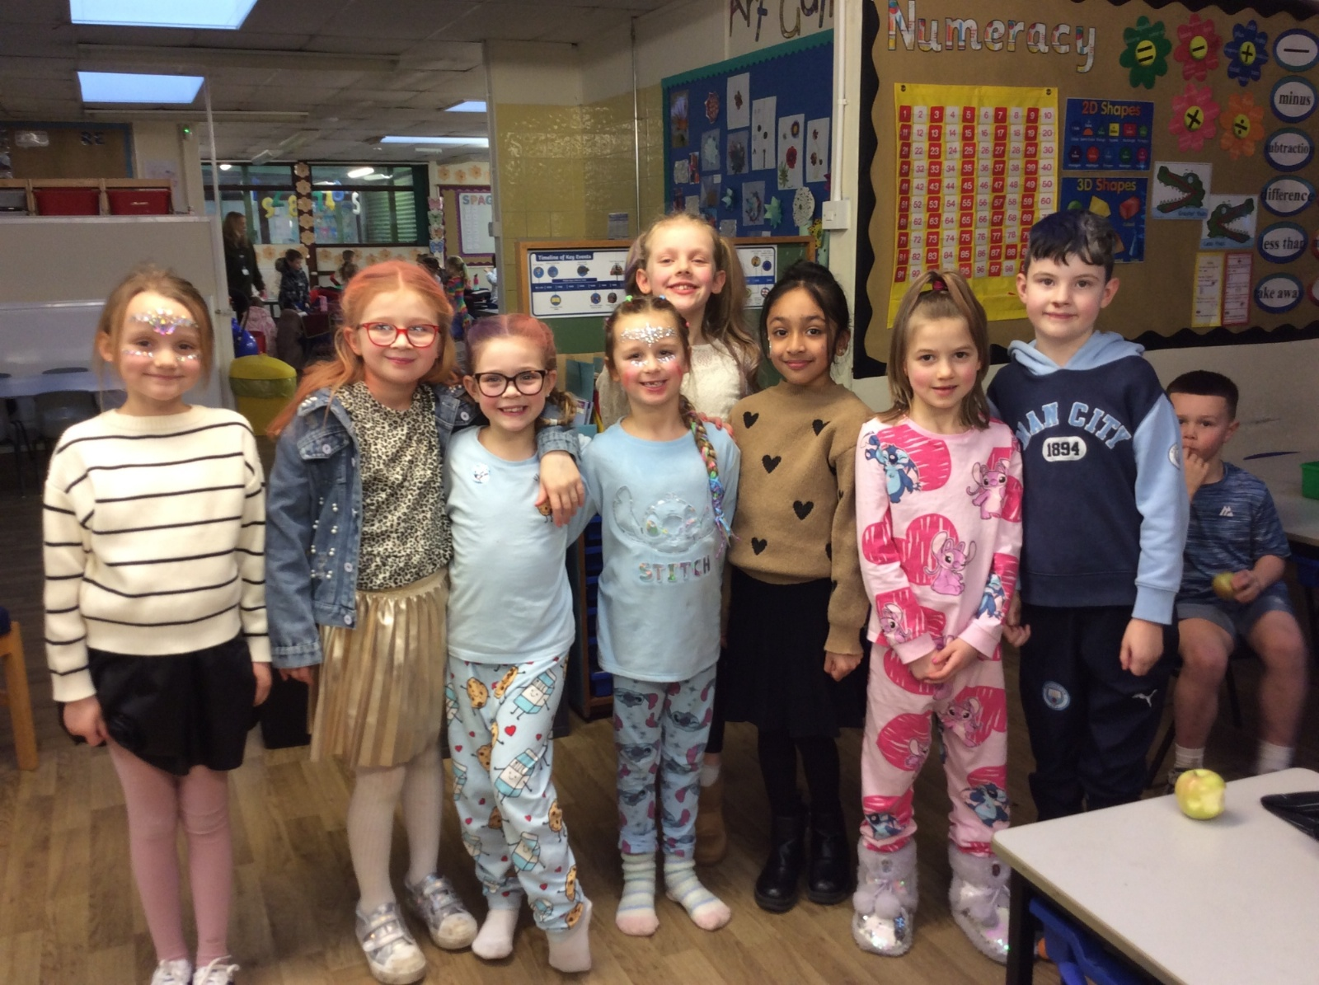
Break The Rules Day
We raised over £400 for Springhill Hospice with our Break The Rules Day.

Slide 7
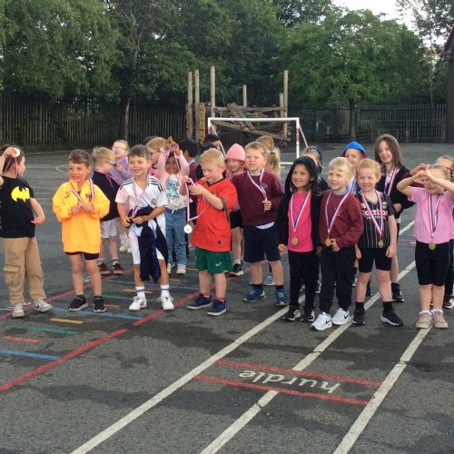
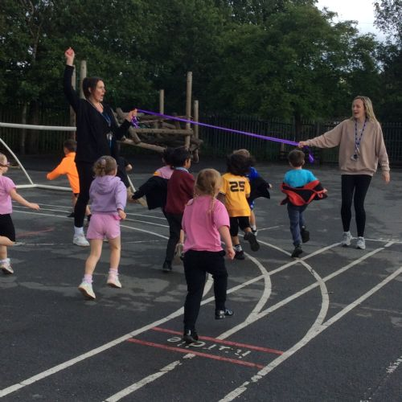
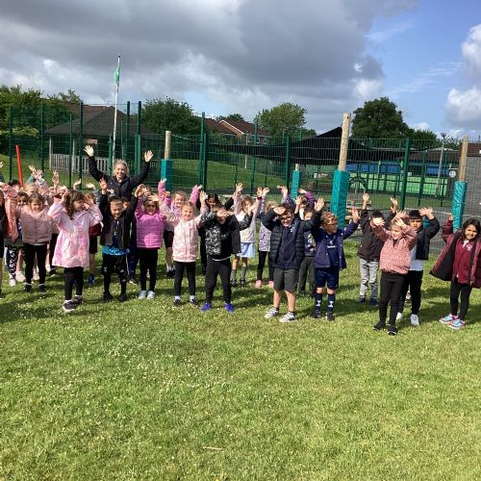
School Race for Life
We raised over £2000 for Cancer Research by completing a School Race for Life.

Slide 8
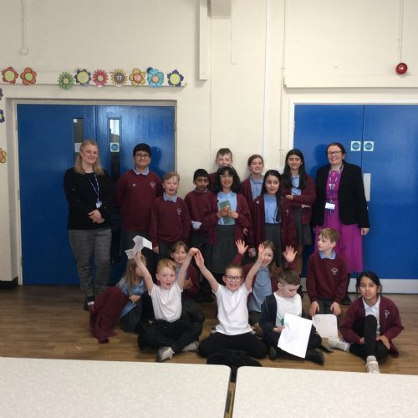
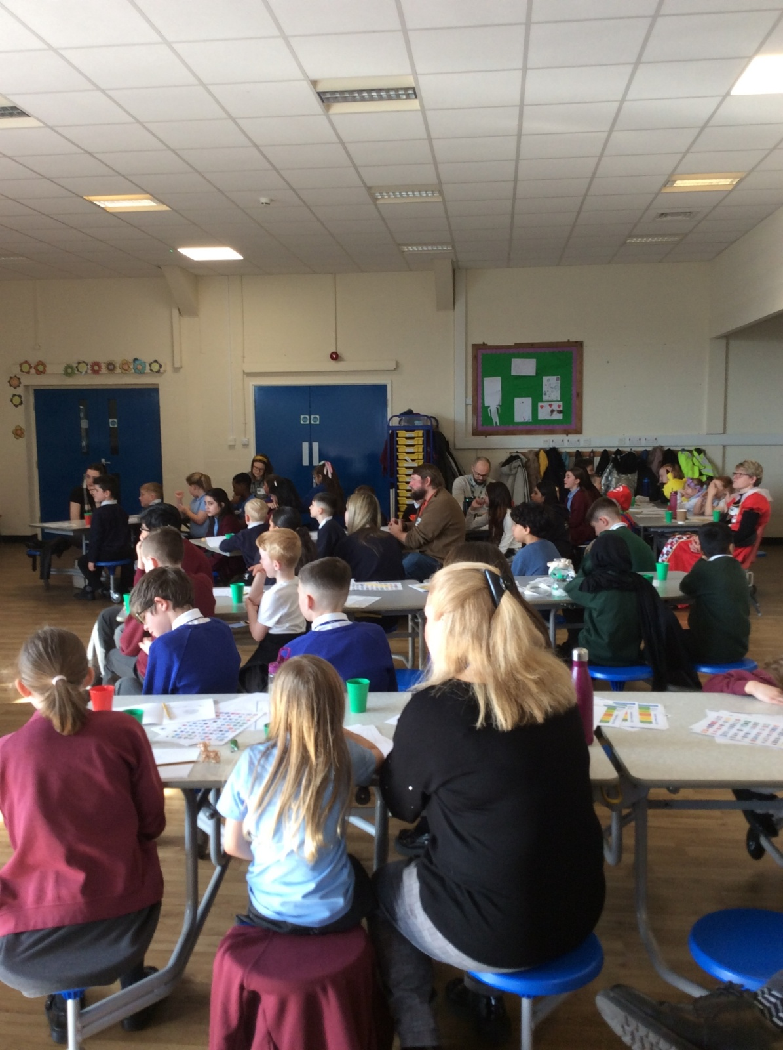
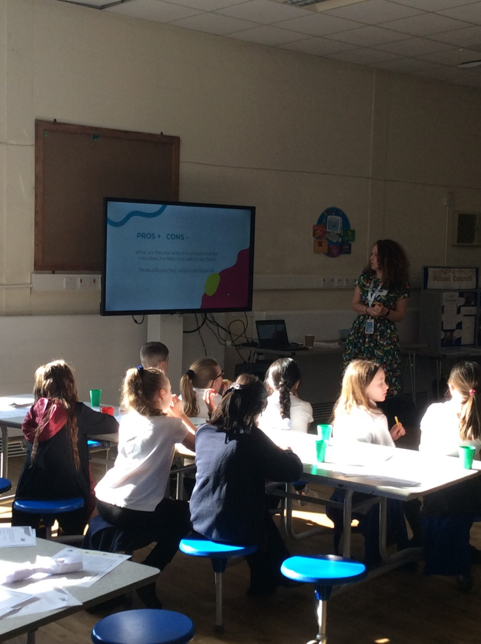
School Council Network Events
We have hosted school council network events during the year.

Slide 9
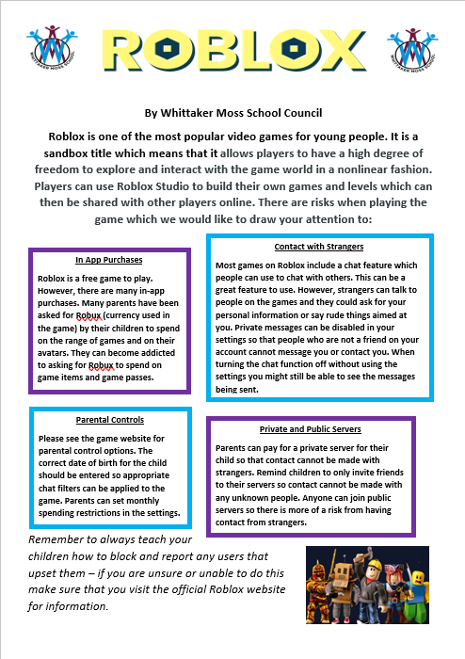
Roblox Leaflet
We created an online safety information leaflet about Roblox for parents for our online safety campaign. This was sent out to all parents.

Slide 10
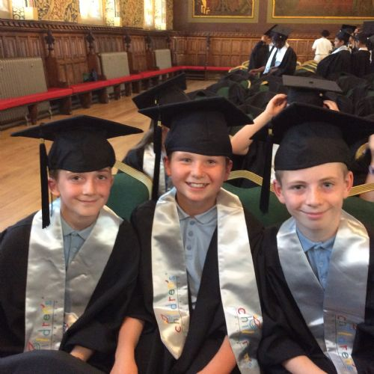
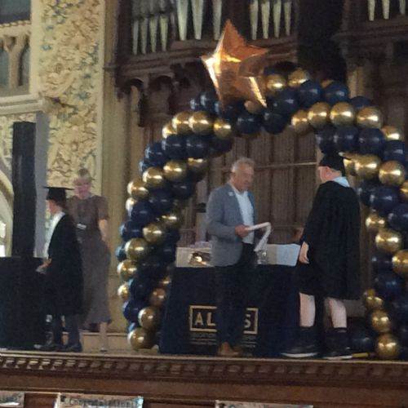
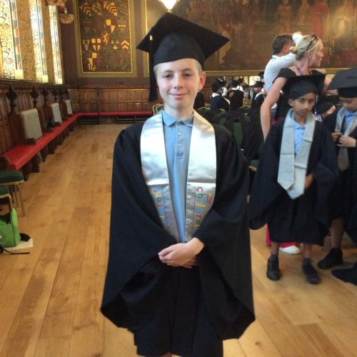
Graduation Ceremony
Some of our councillors got to graduate at Rochdale Town Hall because they achieved thirty hours of extra-curricular activities. These included attending school council meetings.

Slide 11
Other Achievements
Sold Marie Curie Daffodils in March
Met with the school cook and made changes to the menu
Met with the headteacher to negotiate rules to break
Wrote reports for governors
Wrote thank you letters to the PTA

Slide 12
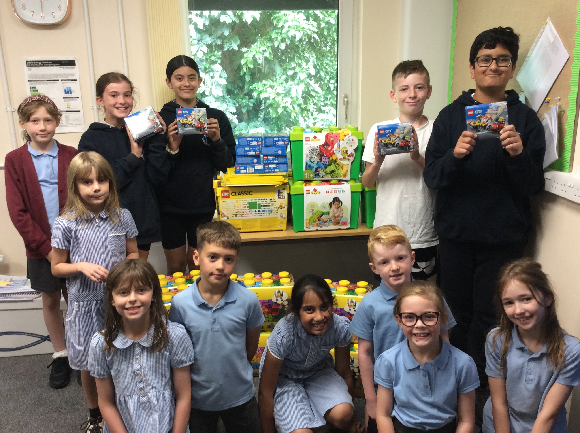
Lego!
We used the money raised over the year to purchase new Lego for every class in school! It was gratefully received!

