Slide 1
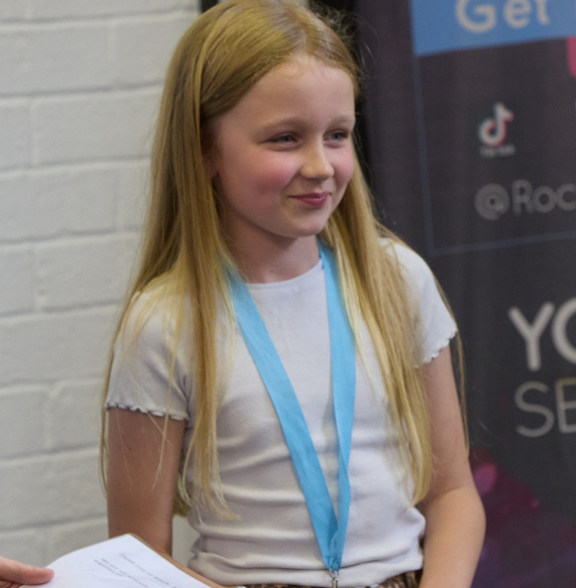
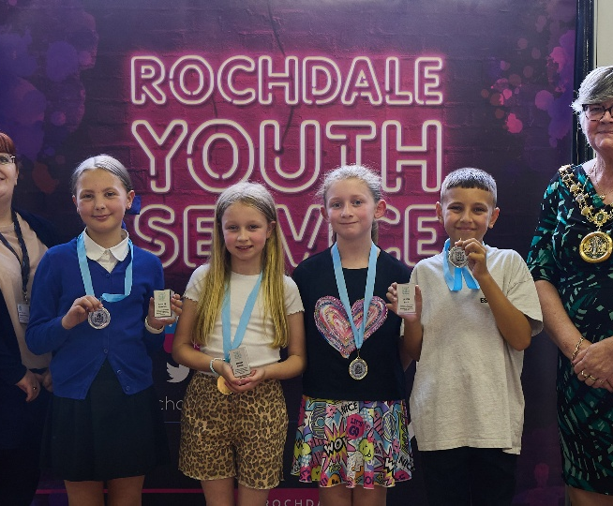
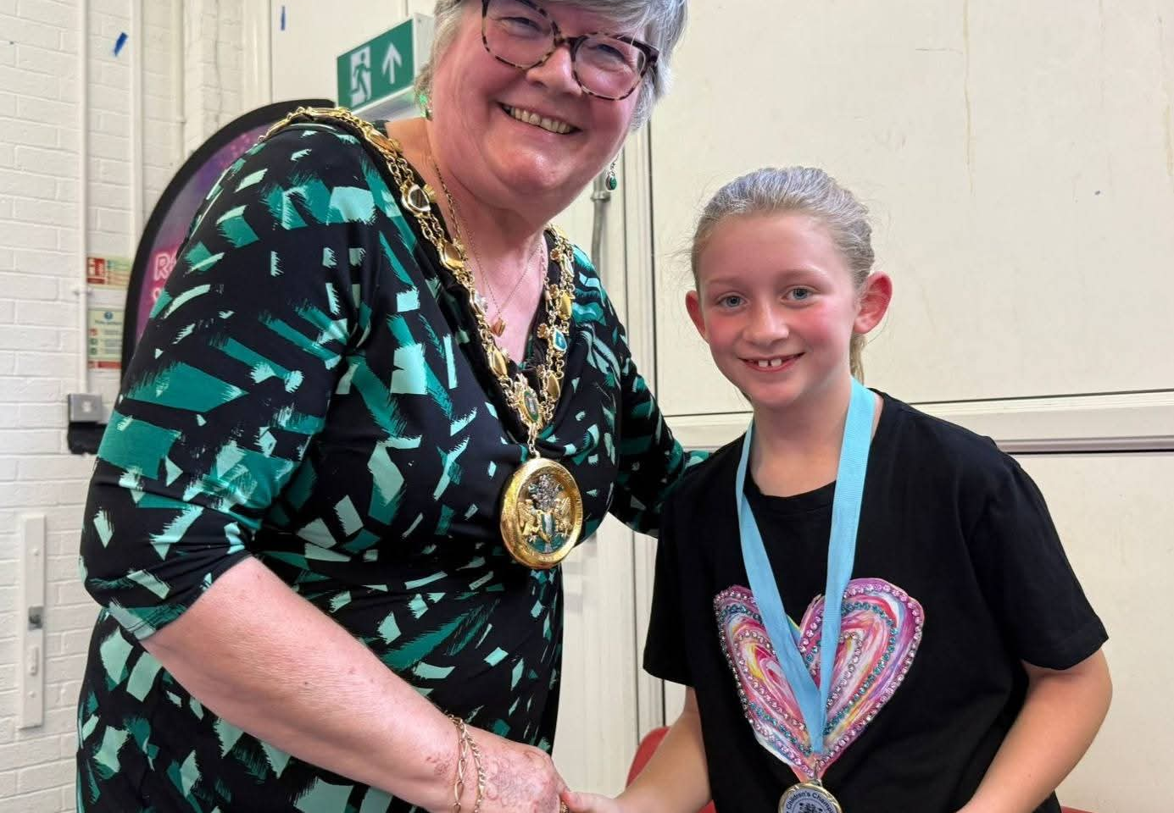
Amelia and Téa as the current
Boroughwide Children’s Champions!
Children’s Champions
Representing
Borough of Rochdale
Notes:
Hello, thank you for inviting us to come to tell you about the Children’s Champions who represent the voice of Children in Rochdale Borough.
Firstly we better introduce ourselves!
My name is Harry Milne and I am the elected Children’s Champion for Rochdale and Pennine neighbourhoods.
And my name is Maisy Heaton and I am the elected Children’s Champion for Heywood and Middleton.
We are going to tell you how we were elected, how the process works and what we will be working on during our term of office.

Slide 2
Rochdale Borough Children’s Council
The aim of Rochdale Borough Children’s Council is to give children and young people of the Borough between the ages of 8-11 a voice which will be heard and listened to by the Local Authority, Police Authority, NHS and many other agencies who have the interests and views of children and young people as a high priority.
The Children’s Champion chair the Children’s Council meetings and they work together to campaign and progress with manifesto points. Anyone is welcome to join the children’s council, so if you are aged 8-11 and want to be involved but not as children’s champion, you can join the Children’s Council anytime!

Slide 3
Role as Children’s Champions and Deputies
Term of office is 1 year
Represent the voice of children from across the borough
Work with the Members of UK Youth Parliament to help improve the lives and services for children and young people in Rochdale Borough.
Attend and chair (take lead) meetings for Rochdale Children’s Council held monthly on a Saturday morning.
To have enthusiasm, energy and take an interest in the rights of children and young people
Notes:
This is what our role is.

Slide 4
Amelia, Norden Pimary School
Campaign Points:
Access to libraries – Amelia wants to encourage more children to access and use local libraries and the services they provide.
Better Parks – and more equipment for all ages. We all deserve somewhere safe and fun to play.
Green Cross Code – raise awareness of it and keep children safer.
I was part of the school council and attended monthly meetings, whilst also engaging in after school and community activities such as choir, football and Brownies.
Notes:
These are the points I am going to campaign on. We are meeting with Sharon Hubber, Director of Children’s Services for Rochdale to talk about what I want to do and I am sure that she will help with ideas and who to speak to about the things I want to change. I already have a meeting with booked in with Diane Higgins (Head of Youth Service) to talk about Junior Youth Clubs and The Children’s Council will be going out looking at the parks we have and the equipment before we meet with Environment team to talk about what changes would be possible.

Slide 5
Téa, St Vincent’s RC Primary School
Campaign Points:
Free school meals- All children should have access to free school meals.
Eco-ambassador – teams which will help make and keep the planet healthier and cleaner.
Worry boxes – and friendship benches to help support children’s mental health and wellbeing.
‘’I am so proud to be from Rochdale and I want the world to know, if you think you know Rochdale, think again. We are the future and we will be heard.”
Notes:
And these are my campaign points. I have already met with Your Trust (Rochdale) to talk about the all weather pitches and will meet with Rochdale Football Club who are looking at plans for new play zones across the borough.
We are going to o to a meeting of Primary head teachers to discuss our campaign points and I really want to talk about being allowed to play and have a break. I think they maybe don’t realise how often this happens. We can also talk about the mental health group idea to see if some schools already do this and what their thought are on how this would benefit children in their schools.
As you can see – we’re going to be busy!

Slide 6
Examples of what Children’s Champion and Deputies do…
Writing and practicing presentations and speeches.
Speaking with service directors to progress on manifesto points.
Creatively gathering information and opinions from children, parents, service users, schools and staff across the borough.
Attend and speak at events as a representative of children.
Meet with Members of UK Youth Parliament.
Feedback at head teachers meetings.
Chair the Children’s Council meetings on the ‘teenth’ (e.g. 13th, 17th) Saturday of each month, 10:00-12:00.
Notes:
And these are my campaign points. I have already met with Your Trust (Rochdale) to talk about the all weather pitches and will meet with Rochdale Football Club who are looking at plans for new play zones across the borough.
We are going to o to a meeting of Primary head teachers to discuss our campaign points and I really want to talk about being allowed to play and have a break. I think they maybe don’t realise how often this happens. We can also talk about the mental health group idea to see if some schools already do this and what their thought are on how this would benefit children in their schools.
As you can see – we’re going to be busy!

Slide 7
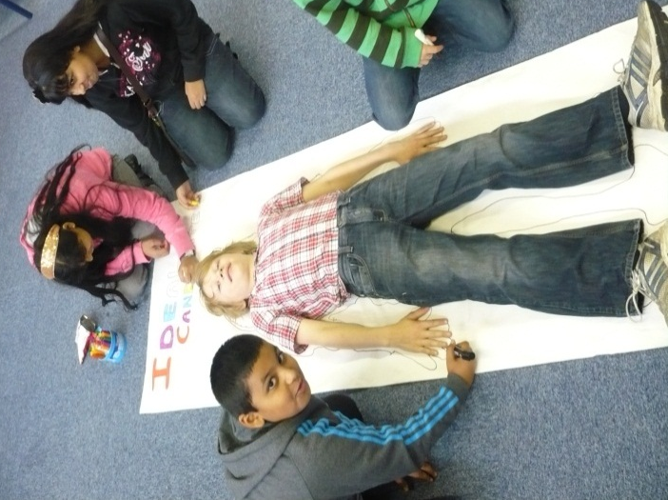
Our ideal Children’s Candidates would be…
Approachable Good listener
Committed Enthusiastic
Friendly Confident
Thoughtful Helpful
Willing learner Reliable
Team player Caring
Notes:
And these are my campaign points. I have already met with Your Trust (Rochdale) to talk about the all weather pitches and will meet with Rochdale Football Club who are looking at plans for new play zones across the borough.
We are going to o to a meeting of Primary head teachers to discuss our campaign points and I really want to talk about being allowed to play and have a break. I think they maybe don’t realise how often this happens. We can also talk about the mental health group idea to see if some schools already do this and what their thought are on how this would benefit children in their schools.
As you can see – we’re going to be busy!

Slide 8
Election Process…
Children’s Champion applicants need to be in years 4 or 5.
The closing date for applications is Friday 8th May. The current children’s champions and council will shortlist the applications.
Interviews will take place on Saturday 16th May.
Candidates will film videos to share in elections packs.
Elections will take place in schools from the week commencing 9th June for 3 weeks, with ballot boxes and resources being dropped and collected from all schools participating.
Results will be announced on Wednesday 8th July 2026!
Good luck to all of you applying! Please feel welcome to ask teachers or us for help with applications, or if you want to join the children’s council. Thank you!!!
Notes:
And these are my campaig9n points. I have already met with Your Trust (Rochdale) to talk about the all weather pitches and will meet with Rochdale Football Club who are looking at plans for new play zones across the borough.
We are going to o to a meeting of Primary head teachers to discuss our campaign points and I really want to talk about being allowed to play and have a break. I think they maybe don’t realise how often this happens. We can also talk about the mental health group idea to see if some schools already do this and what their thought are on how this would benefit children in their schools.
As you can see – we’re going to be busy!

