Slide 1
Whittaker Moss School Council
Platinum Presentation 2026

Slide 2
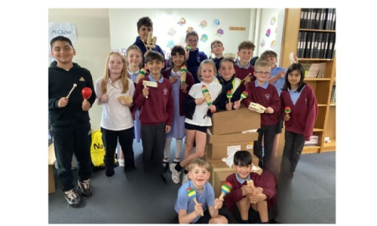
What we have done over the year.
We have been very busy!

Slide 3
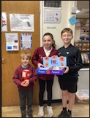
We sold poppies for the Royal British Legion. £350!

Slide 4
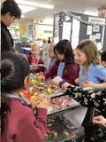
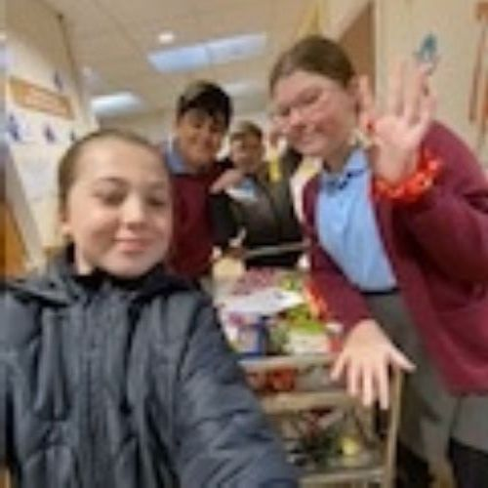
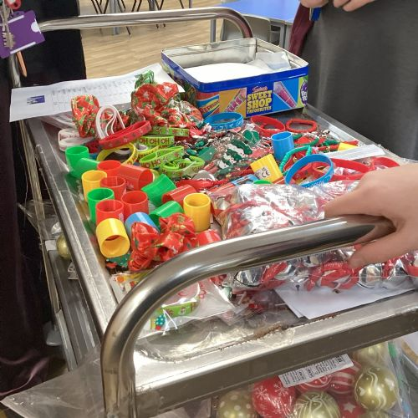
We ran a Christmas Trolley to raise money for school. £600!

Slide 5
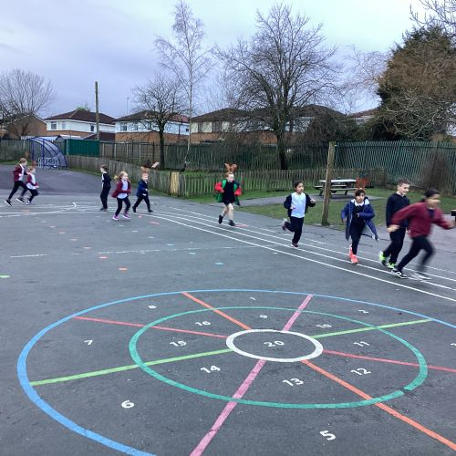
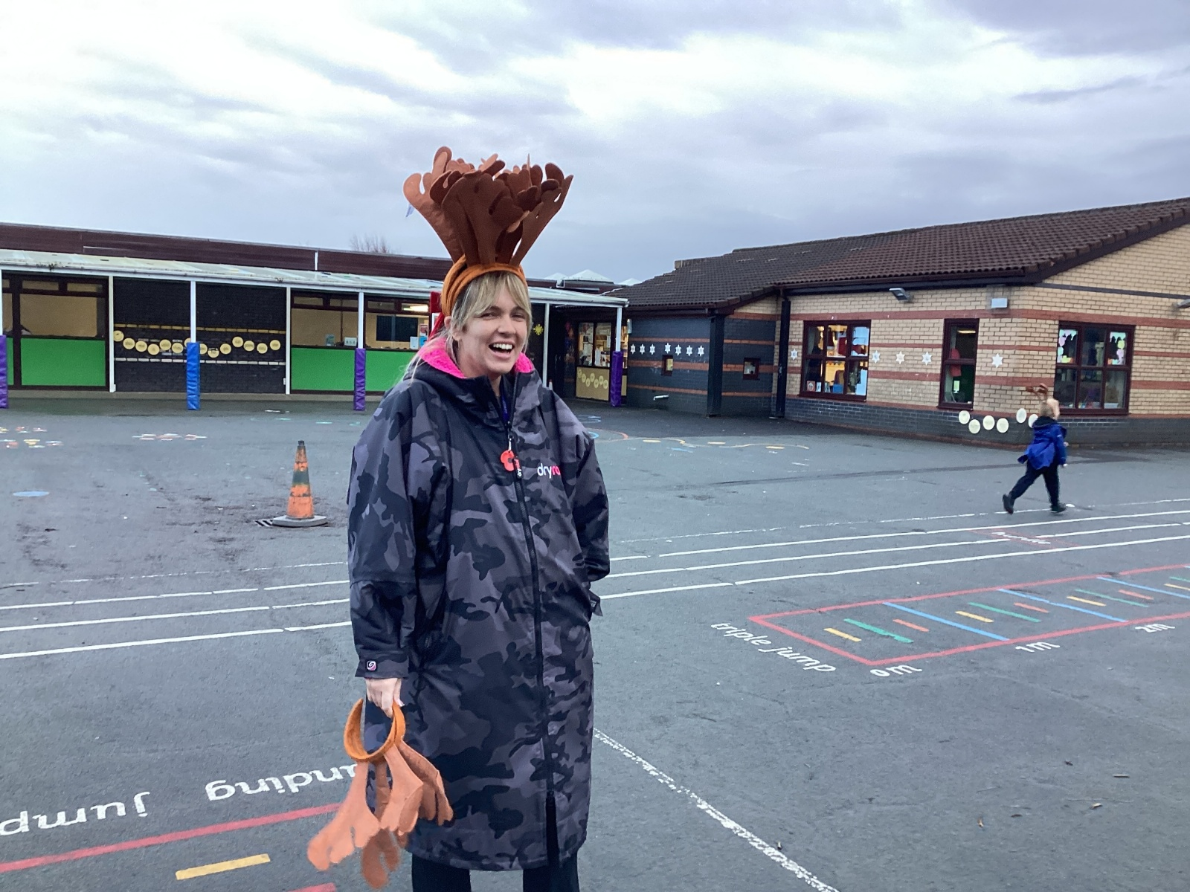
We took part in the Reindeer Run for Springhill Hospice! £1600!

Slide 6
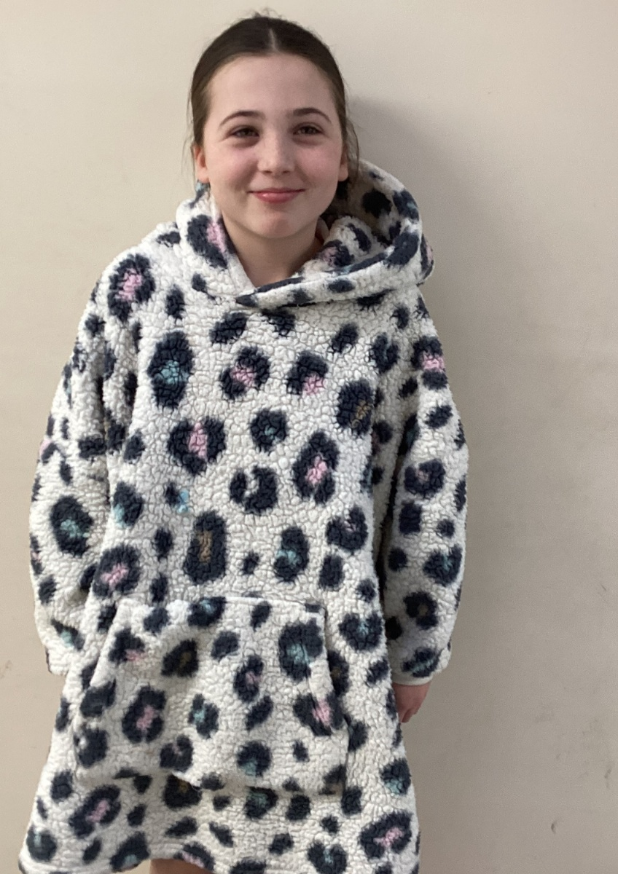
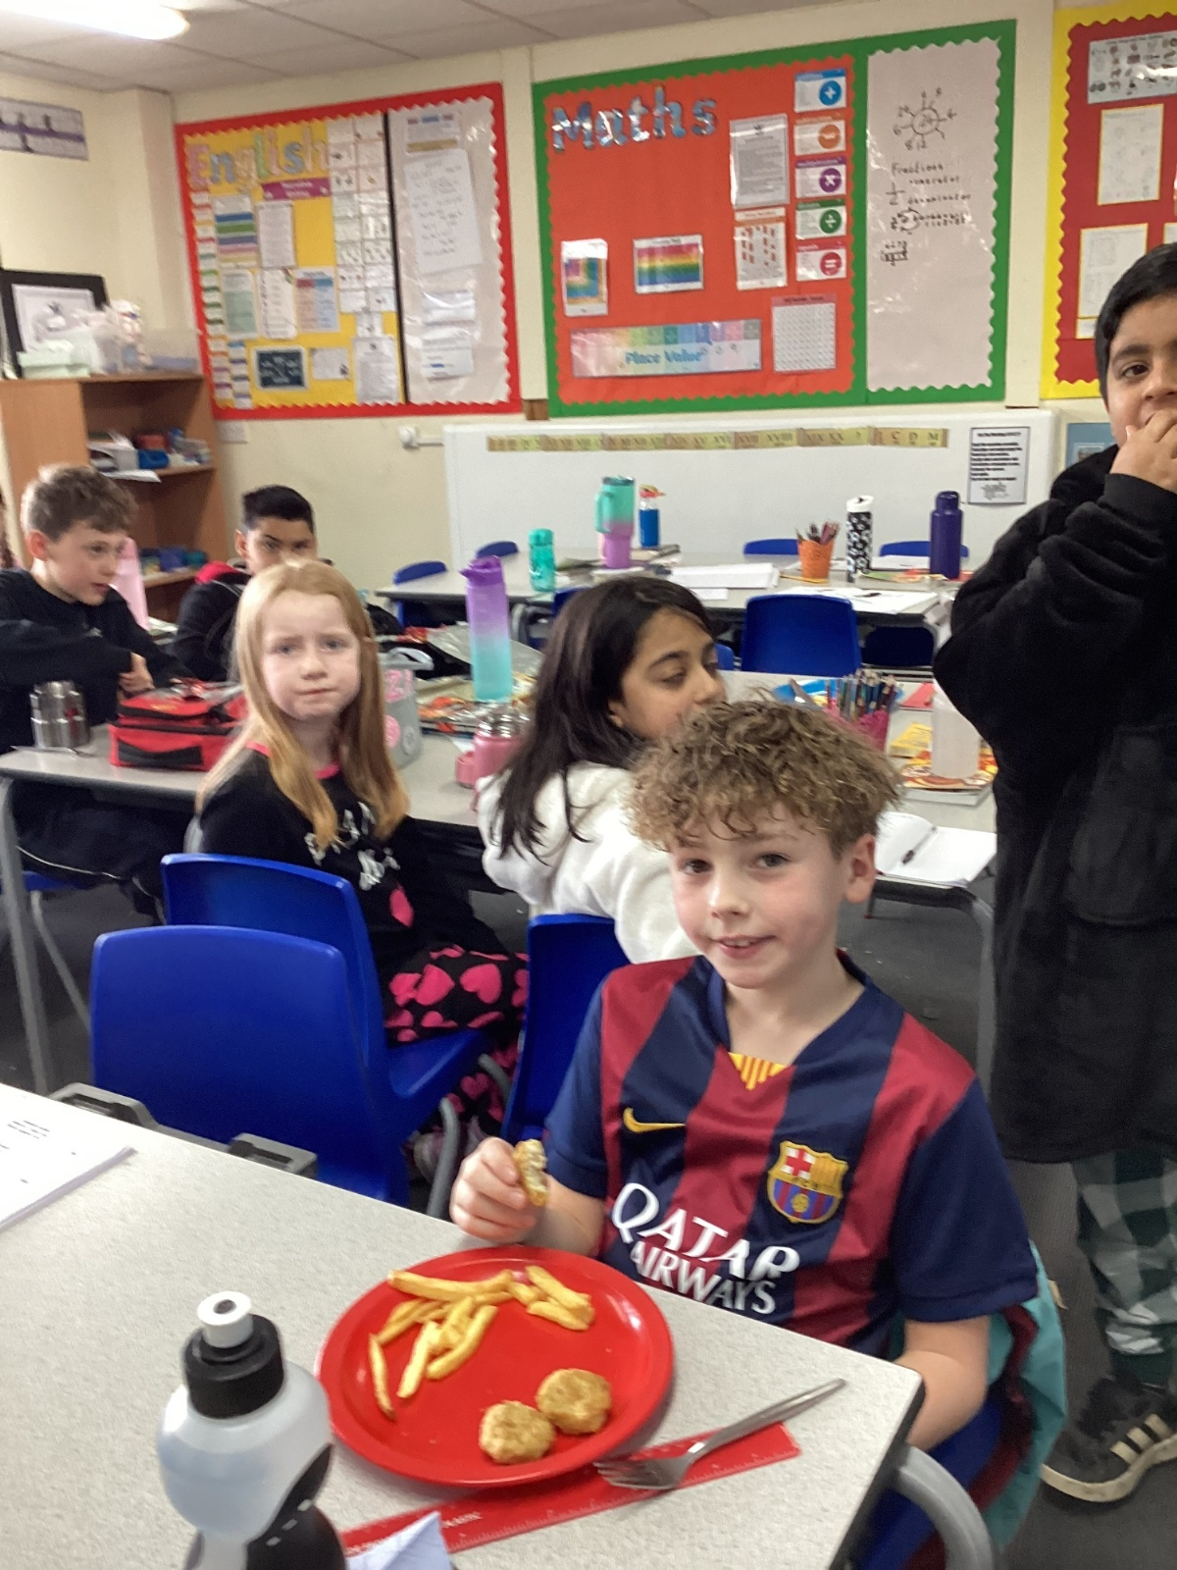
We held a movie and pyjamas day for Manchester Children’s Hospital. £450!

Slide 7
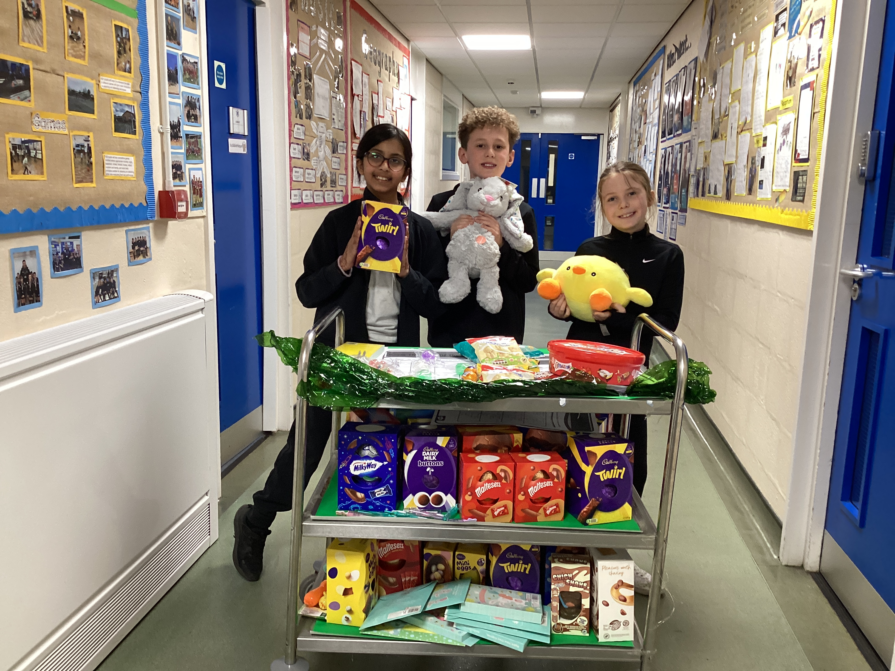
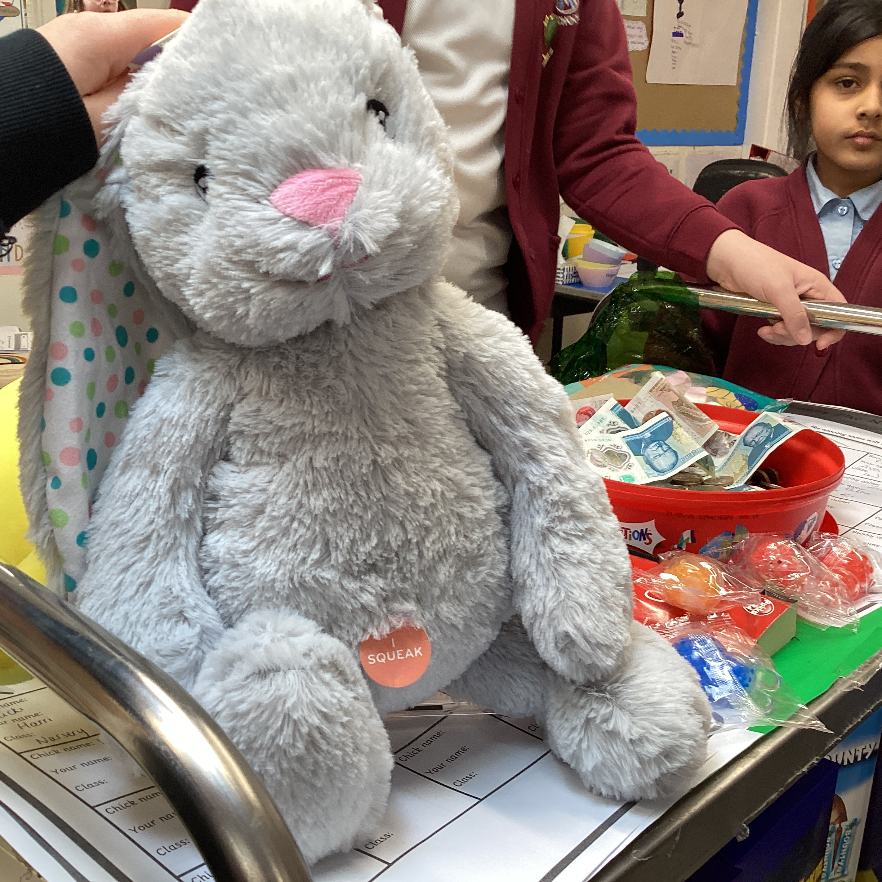
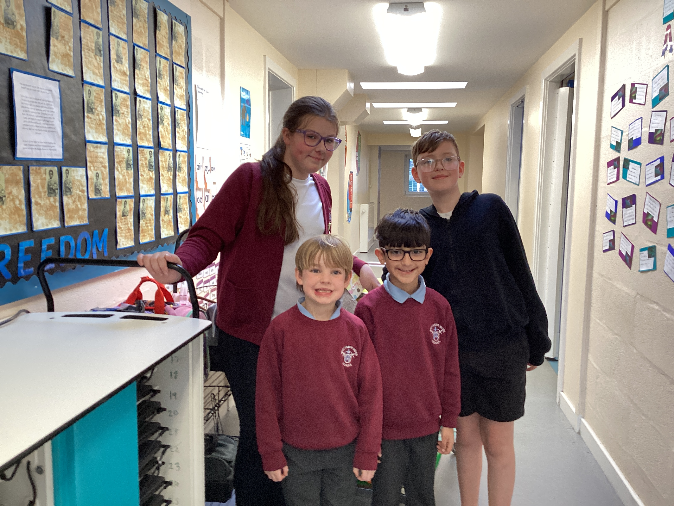
We ran an Easter raffle and name the bunny and chick competition. We raised £500!

Slide 8
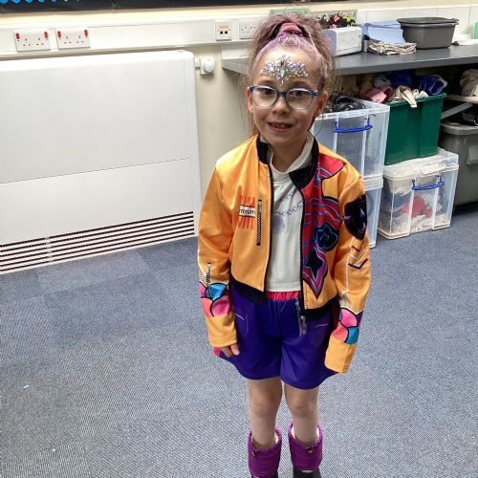
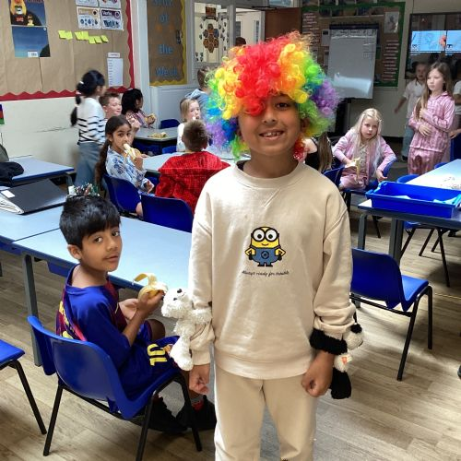
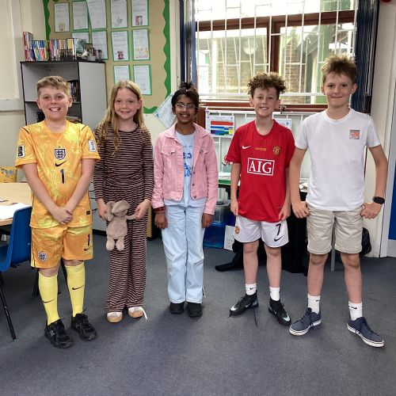
We held a Break The Rules Day for Cancer Research. £650!

Slide 9
We bought new instruments for the whole school with money we raised over the year.

Slide 10
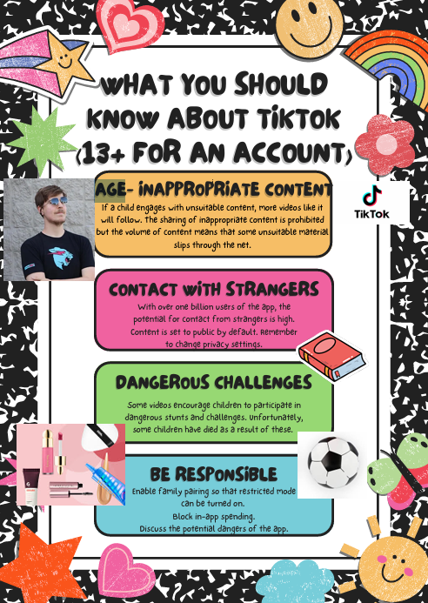
For Platinum level, as well as raising money, you need to run a campaign over the year. We chose online safety.

Slide 11
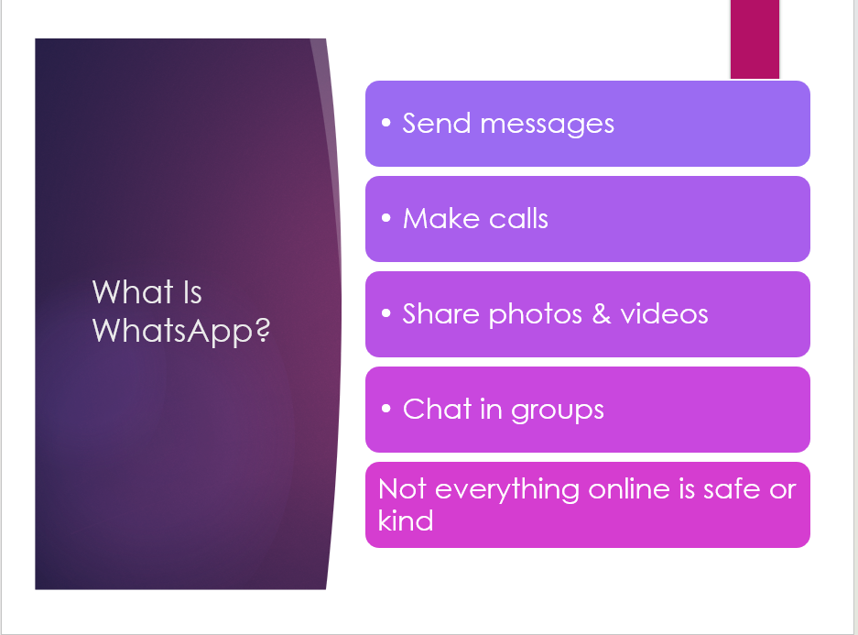
Eliza created a leaflet about Tik Tok which was shared with parents and pupils.
We joined up with the school Digital Leaders to create and lead an assembly for the whole school on the responsible and sensible use of Whatsapp..

Slide 12
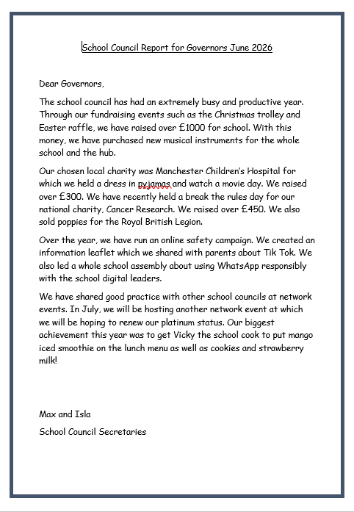
Other achievements:
Meeting with Vicky, the school cook and got Mango sorbet added to the lunch menu! She also brought back cookies and milk!
Regular reports to governors.
Two year five pupils are Children’s Champion finalists.
Attended and hosted network events.
Lots of councillors earned enough credits to graduate at the Children’s University ceremony at the town hall.

Slide 13
We would now like to share our Whatsapp Presentation with you.
Using WhatsApp safely, kindly, and responsibly
Like riding a bike:
• Fun
• Connects people
• Needs rules

Slide 14
Thank You!
Thank you for listening. Do you have any questions?

