Slide 1

Vote for Hibah for School Council

Slide 2
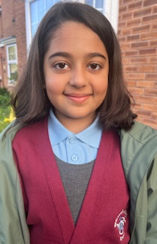
About me :
Hi, My name is Hibah and I am in year 4.
I love gymnastics, singing and dancing, drawing and helping my friends.

Slide 3
Why I want to be on the School council.
I want to be the voice of my fellow students. I would love to listen to your ideas and share them with the school management.
I would be able to help my fellows more efficiently; not just in the class but also around the school.
Because I love my school, I want to be a part of planning fun activities to raise more funds for school.
And I want to experience how is it like being a representative. I want to practise my confidence and judge my leadership qualities.

Slide 4
What makes me a good councillor
It is my love for school.
My kind and respectful nature
My honesty and dedication.
And I am a good listener.

Slide 5
My Suggestions
In addition to already running events, there can be extra fun yet creative activities like
Bake sale ( in addition to McMillan Coffee morning).
Pancake breakfast- can be a community event.
Whole school art and craft sale. It could be anything like paintings, drawings, handmade cards even embroidered or knitted items.
Inhouse/in school sports competition throughout the year so that everyone can participate who don not get chance to play in team (like me).

Slide 6
Let’s work together
We need to arrange additional charity and fund-raising events not only for our school but also for our official Charity SpringHill Hospice.
You should all share your ideas, and we can work together as a team to make this academic year a real success.

Slide 7
Thank you!
Thank you for listening
Vote for Hibah Imran- 4W
Let’s make our school the best as it can be….Together

