Slide 1

Think Before You Send!
Using WhatsApp safely, kindly, and responsibly
Like riding a bike:
• Fun
• Connects people
• Needs rules

Slide 2
What Is WhatsApp?
• Send messages
• Make calls
• Share photos & videos
• Chat in groups
Not everything online is safe or kind

Slide 3
Golden Rule: Pause Before You Post
Ask yourself:
1. Is it kind?
2. Is it true?
3. Would I be happy if everyone saw it?
If NO — don’t send it

Slide 4
Being Kind Online
Words online can hurt
Instead:
• Include others
• Use friendly words
• Think about feelings

Slide 5
Photos and Privacy
Never share:
• Personal info
• Address
• Passwords
Always ask before sharing photos
“My information belongs to me”

Slide 6
Group Chats
• Don’t spam
• Don’t exclude
• Don’t send upsetting content
If uncomfortable:
• Leave
• Mute
• Tell an adult

Slide 7
Strangers Online
If you don’t know them:
• Don’t reply
• Don’t share info
• Tell an adult
Online strangers are still strangers

Slide 8
Screen Time Balance
We also need:
• Sleep
• Exercise
• Reading
• Outdoor play
• Real conversations

Slide 9
If Something Goes Wrong
1. Stop
2. Don’t reply
3. Tell a trusted adult
You won’t get in trouble for asking for help

Slide 10
Quick Quiz
Password sharing?
Ask before posting photos?
Join in mean messages?
Tell an adult if worried?

Slide 11
Quick Quiz
Password sharing? ❌
Ask before posting photos? ✅
Join in mean messages? ❌
Tell an adult if worried? ✅

Slide 12

Key Message
Be Kind. Be Safe. Think Before You Send.
Every message leaves a footprint

Slide 13
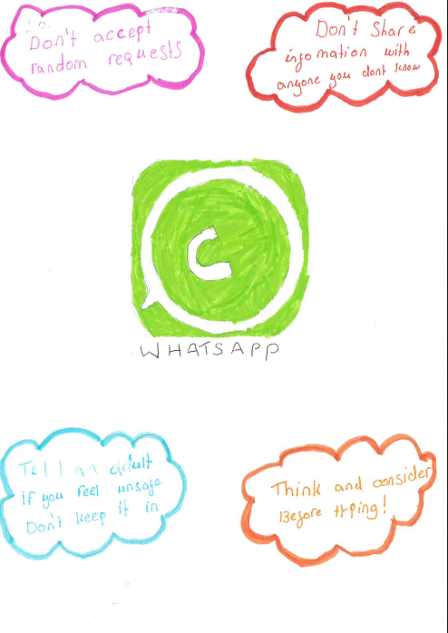

Slide 14
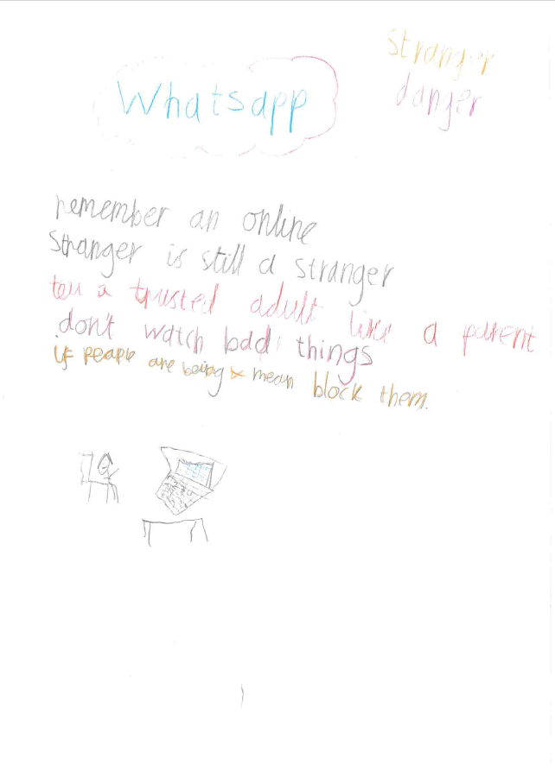

Slide 15
Closing
Use technology to help and connect safely
Pause. Think. Be Kind.

