Slide 1


Children’s
Champion for the Borough of Rochdale Elections 2022

Slide 2
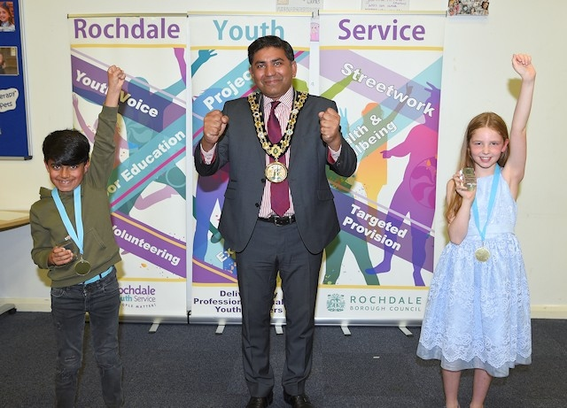
Grace Butterworth is the current Children’s Champion and attends Whittaker Moss Primary School.
Hashim Hussain is the current deputy Children’s champion and attends Bellfield Primary School.

Slide 3
Children’s Champion and Deputy!
The term of office for a Children’s Champion and Deputy is 1 year
The aim is to give children and young people of the Borough between the ages of 8-11 a voice which will be heard and listened to by the Local Authority,
Police Authority, NHS and many
other agencies who have the
interests and views of young
people as a high priority and have the authority to help make a positive difference.

Slide 4

Ideal Candidates…
Approachable
Committed
Friendly
Thoughtful
Willing Learner
Team Player
Good Listener
Enthusiastic
Confident
Helpful
Reliable
Caring
Passionate

Slide 5
Children’s Champion and Deputy
Roles and Responsibilities
The Children’s Champion and Deputy Children’s Champion is a fantastic chance for two young people to represent the children and young people of Rochdale Borough.
It will mean they will have to have lots of energy, enthusiasm and time to work hard in getting children and young people’s voices heard.
The list below shows some of the things the Champion and Deputy Champion will be involved in and describes the role of the Children’s Champion and Deputy (the Deputy will be a young person who will work with the champion).

Slide 6
Roles and Responsibilities Continued…
To support and speak for Rochdale Children’s Council, making sure all children and young people in Rochdale Borough have a say and get answers to any questions they may have.
To work with the Member of Youth Parliament to help improve the lives of children and young people in Rochdale Borough.
To attend and chair (take lead) meetings for Rochdale Children’s Council.
To meet every three months with Member of Youth Parliament, Youth Council and Children’s Council.
To have enthusiasm, energy and take an interest in the
rights of children and young people and work in getting
this message to all children of the Borough
of Rochdale.

Slide 7
How to Apply?!
APPLICATION FORM – ask staff for a copy
Applications will be shortlisted and interviews will take place. Candidates will do in to the democratic elections and the newly elected Children’s Champion will be announced!
Contact us at:
Rochdale Borough Youth Cabinet
Matthew Moss Youth Centre
Matthew Moss Lane
Rochdale
OL11 3LU
Tel: 01706 924296
Email: angela.mccormack@rochdale.gov.uk
Also check out this website for information about
www.rochdaleyouthvoice.co.uk

Slide 8
Children’s Council
Do you want to have your voice heard and make improvements across Heywood, Middleton, Rochdale and Pennines, but do not fancy applying to be Children’s Champion?
Do you want to keep your input local and not make a commitment?
Do you fancy coming on fun trips, meeting with decision makers and supporting the Children’s Champion is achieving their goals?
Did you answer YES to any of these questions? Then get in touch to join the children’s council! We meet monthly on the ‘teenth’ Saturday of the month, 10:00 – 12:00 at Matthew Moss Youth Centre and the group is led by young people, for young people, to make lives better for young people – and it is great fun with lots of opportunities!

