Slide 1


Welcome to your new class
WHITTAKER MOSS PRIMARY SCHOOL
 | Headteacher: Mrs Melanie Backhouse
 | Highwood,Norden,Rochdale,OL11 5XP Telephone / Fax: 01706 342342 e-mail: office@whittakermoss.rochdale.sch.uk Web site: www.whittakermoss.rochdale.sch.uk
You will be in 6W next year.

Slide 2
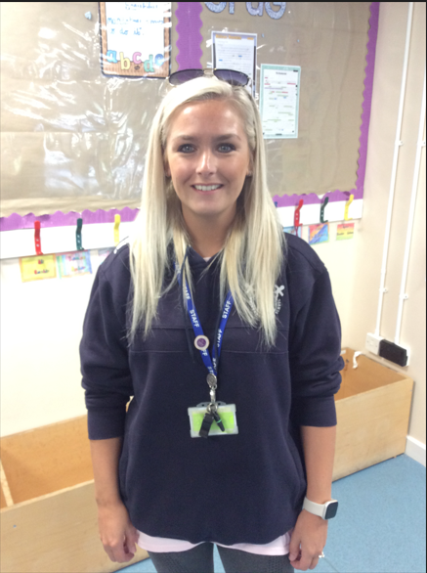
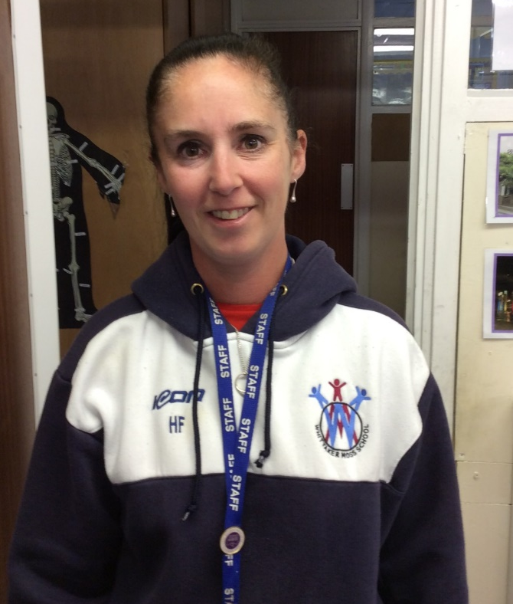
People who help me
Mrs Flint
Miss Lupton
photo

Slide 3
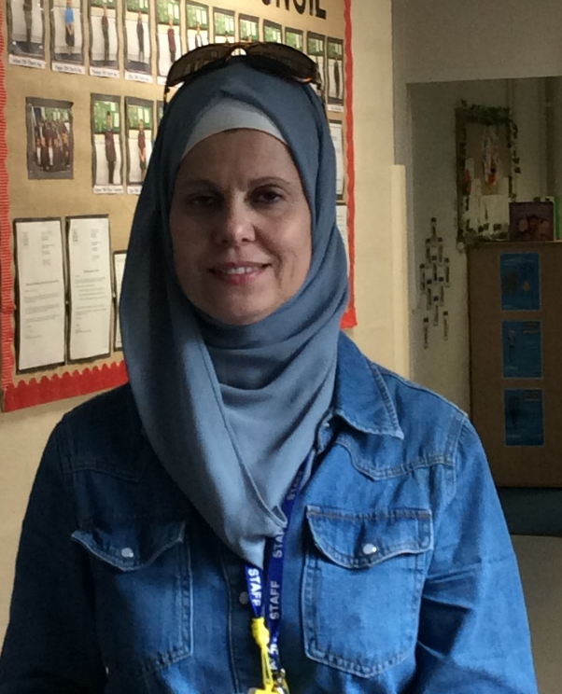
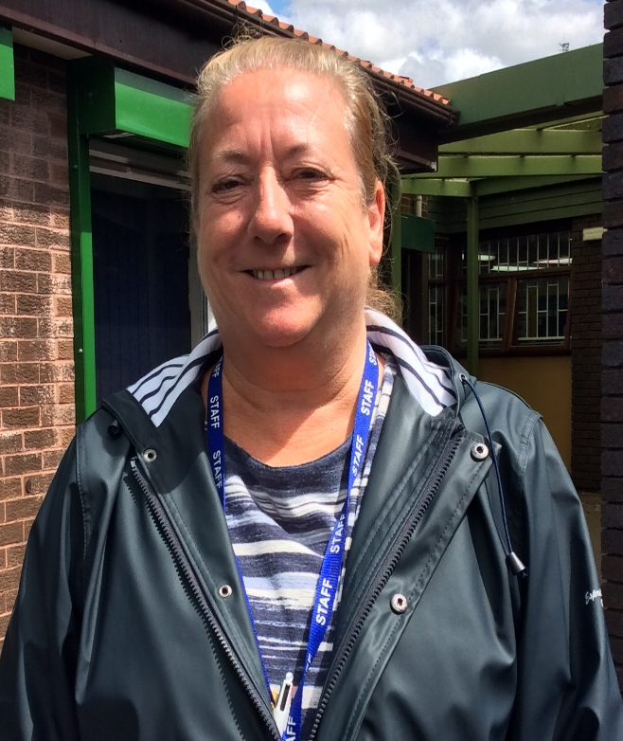
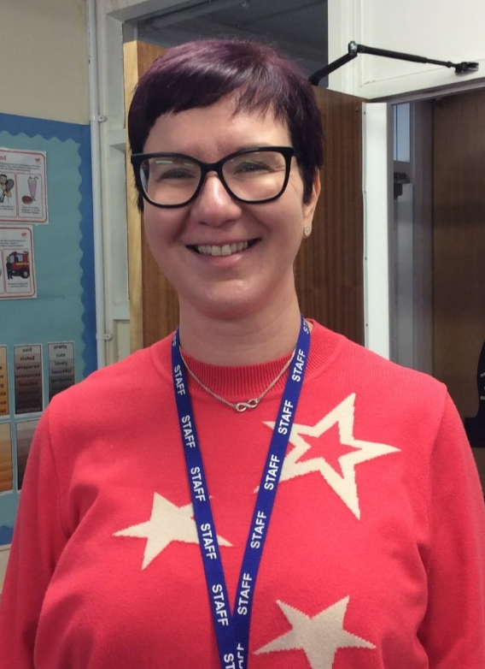
People who help me in my class
Mrs Hafdh TA
Mrs Murphy (PPA)
Madame Audren
photo

Slide 4
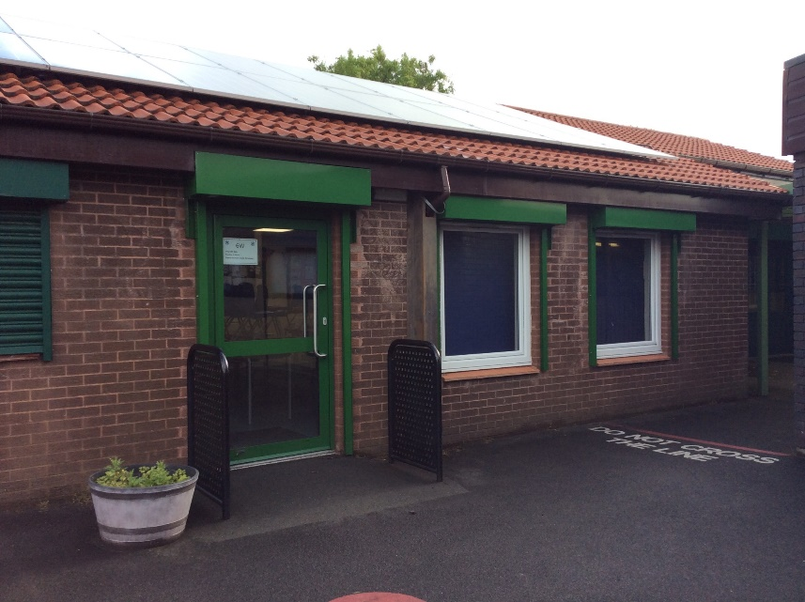
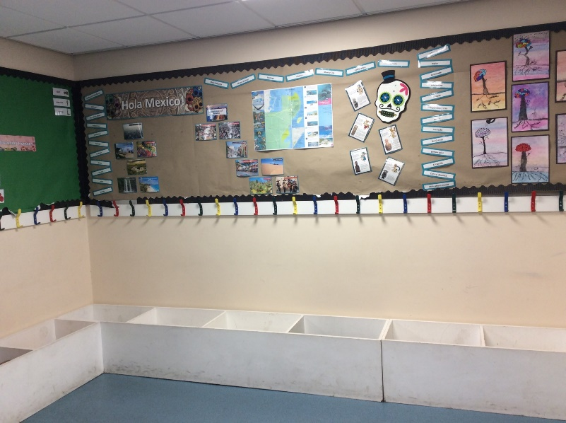
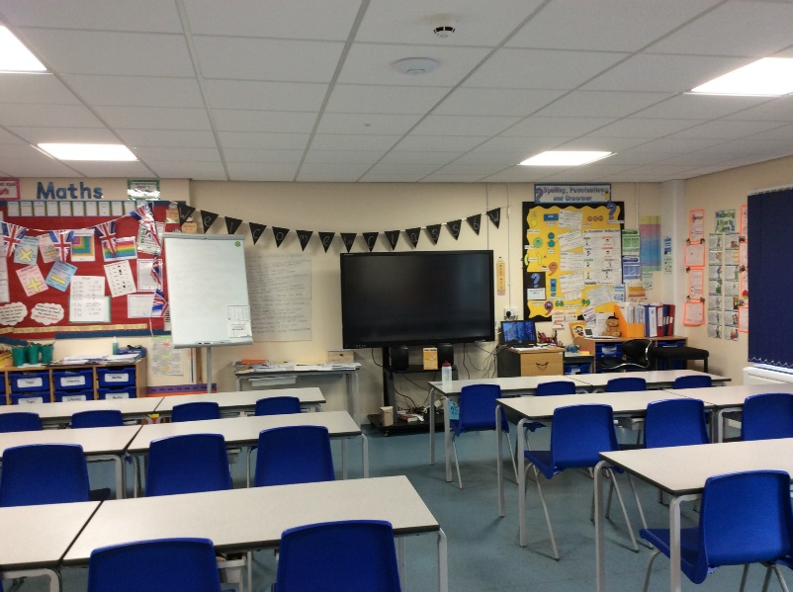
When I get to school
My classroom door on the back playground:
My cloakroom:
My classroom:

Slide 5


Things I need to know
PE and Games days
Other information
Wednesday and Friday
Please ensure correct PE kit is worn on PE days:
Black/ Navy bottoms,
Plain white t-shirt,
Black/ Navy jumper/jacket.
No Logos.
Hair tied back and all earings must be taken out.
Children must only bring a book bag to school. No Rucksacks due to lack of room.
All school equipment will be provided so children will not need a pencil case.
Please use a school water bottle.
Homework days
Monday – Spellings/ Grammar
Tuesday – Comprehension
Wednesday – Maths
Thursday – Maths – Topic based.
Friday – Homework Diary

Slide 6
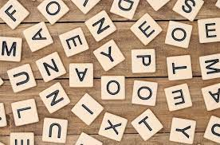

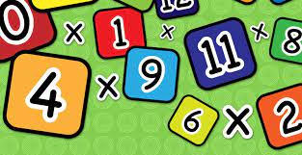
Things I need to know
Spelling
Reading
Spelling tests will take place on a Friday. There will be activities set on Spelling shed to help you to learn these words.
It is really important in Year 6 that we read at home at least 3 times a week to a grown up. This will really help you with all aspects of work through out the year.
You will be given a specific day to bring your reading books back every week.
You do not need to finish the book in a week- Just show us that you are reading.
Times Tables
Remember to practice your times tables as often as you can. TT Rockstars and Maths Shed are great ways to keep up with those skills.

Slide 7
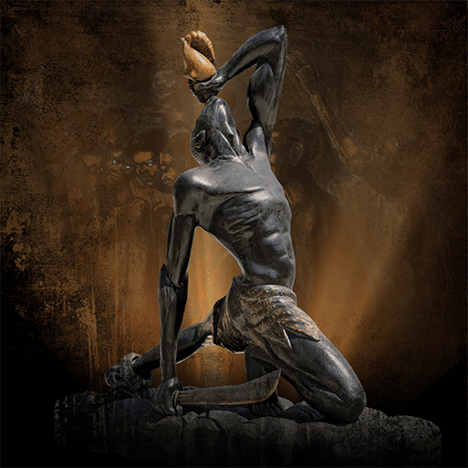
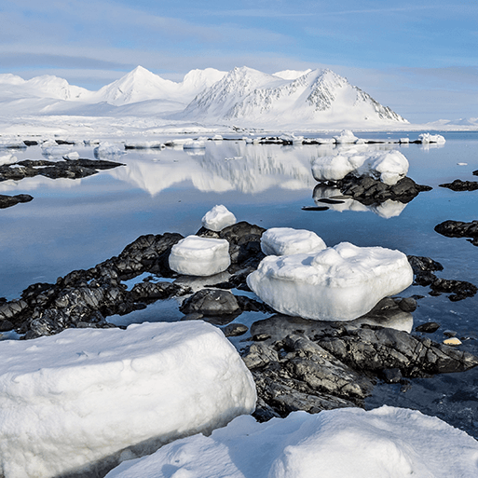
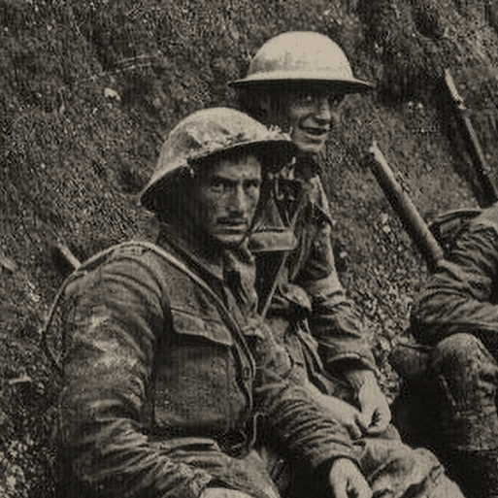
Topics I will be learning about this year
Frozen Kingdoms
Britain at War
Maafa

Slide 8
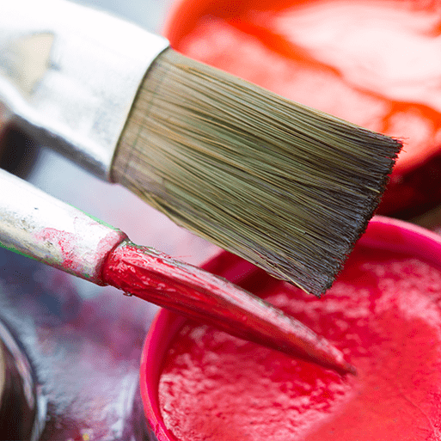
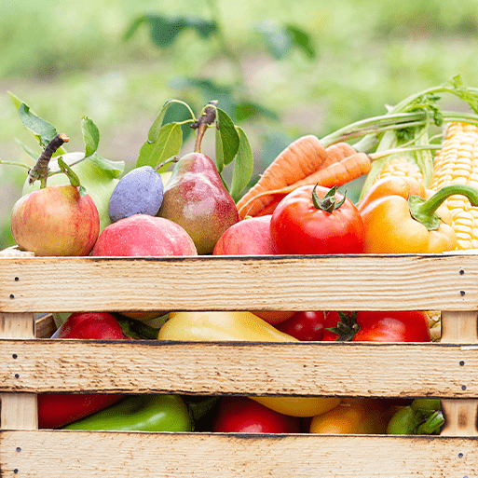
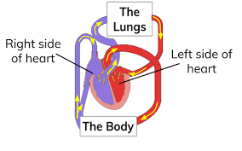
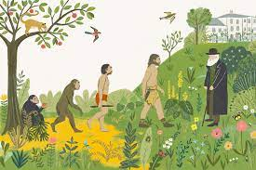
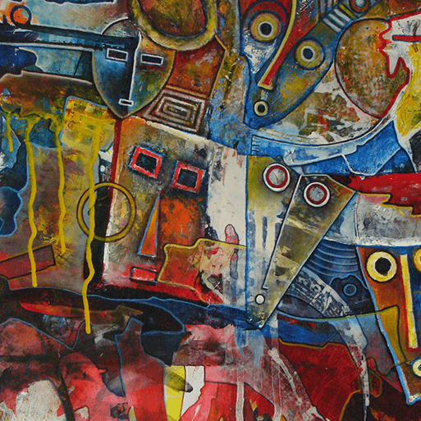
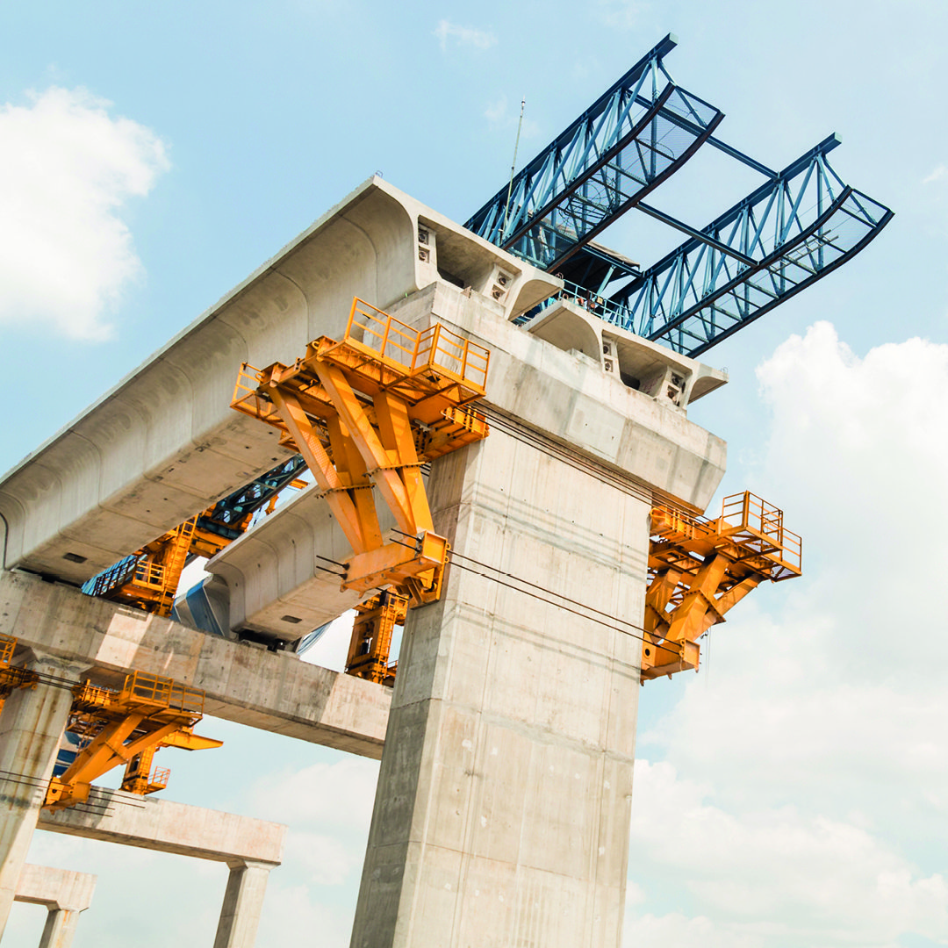
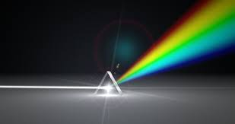
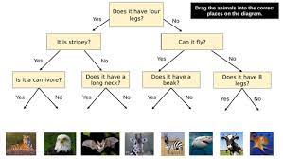
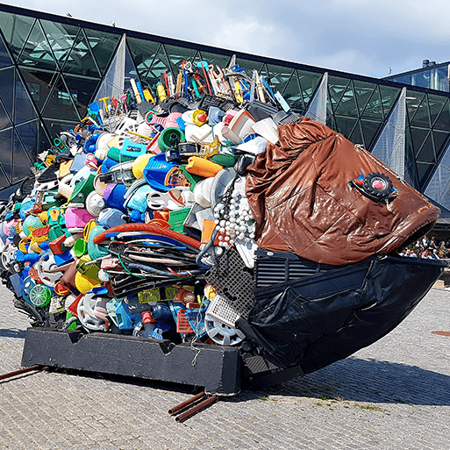
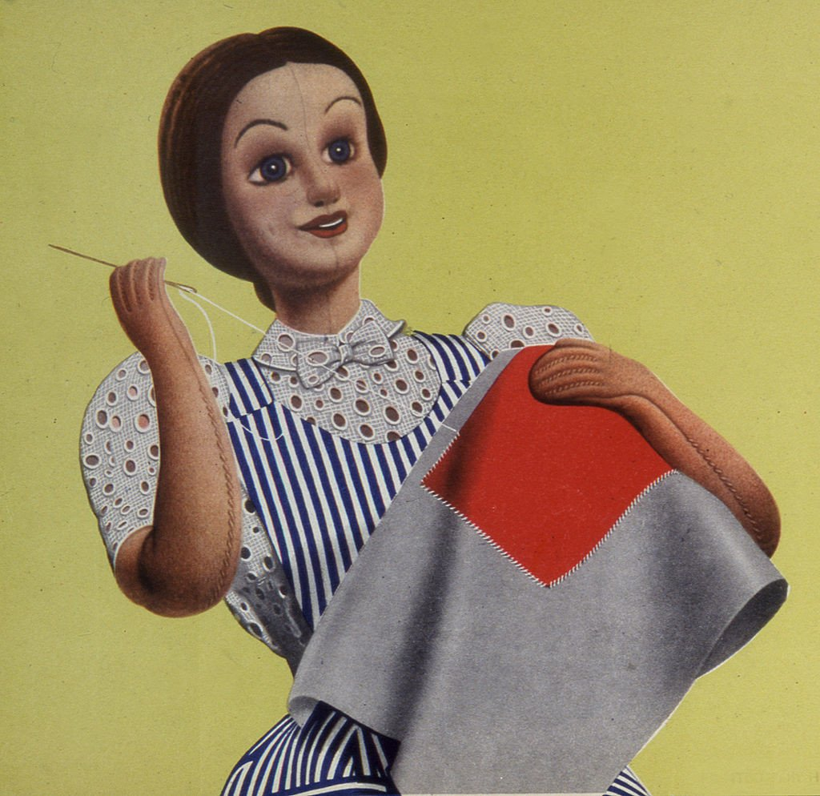
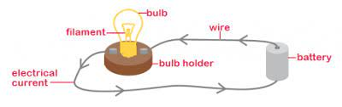
Topics I will be learning about this year:
Food for life
Circulatory
system
Evolution and Adaptation
Tints, tones
And Shades
Trail blazers
Engineer
Light
Classification
Make do and mend
Electricity
Environmental
art

